Slide 1


BUILD AN AI CALORIE TRACKER

Slide 2



Project Overview
In this project, we will build a Calorie Tracker, an app that uses AI vision to identify food from a picture and estimate its nutritional information!
Imagine taking a photo of your lunch and instantly getting calorie counts and macronutrient breakdowns.
Model Input
Model Output
Grilled salmon fillet: 370 calories
Roasted potatoes: 150 calories
Mashed potatoes: 70 calories
Steamed broccoli: 25 calories
Lemon wedge: 2 calories
Olive oil or butter: 50 calories
© All rights reserved for Dr. Ryan Ahmed @Stemplicity Inc.
OpenAI API

Slide 3
What is Prompt Engineering?
Prompt engineering is the practice of designing and optimizing text input to generative AI models to obtain desired responses.
It is the art of communicating with a generative AI model.
“Recommend a book.”
High-quality prompts guide the AI model to generate better outputs.
“Recommend a fiction book.”
© All rights reserved for Dr. Ryan Ahmed @Stemplicity Inc.
“Recommend a historical fiction book set in World War II.”

Slide 4
Prompt Components
Context: background knowledge to help the model understand the domain.
Assume that you are an expert financial analyst
Classify the following text as positive, neutral, or negative
Text: “Apple stock increased by 2% in today's trading session”
Sentiment:
Instruction: A clear statement of the desired goal.
Context
Input Data: The data the model needs to process to produce output.
Instruction
© All rights reserved for Dr. Ryan Ahmed @Stemplicity Inc.
Output Indicator: tells the model the format of the output.
Input Data
Output Indicator

Slide 5
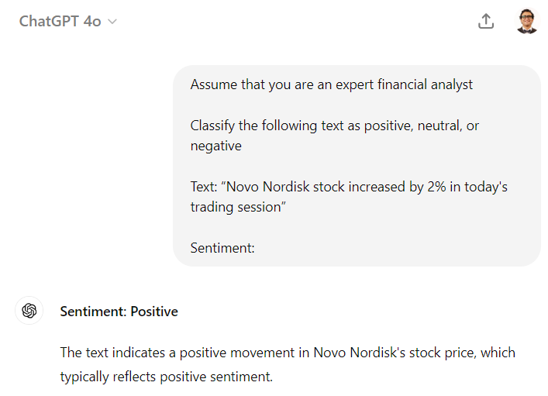
Prompt Engineering Example
© All rights reserved for Dr. Ryan Ahmed @Stemplicity Inc.

Slide 6

Prompt Engineering Techniques: Zero-Shot Prompting
Zero-shot prompting refers to the ability of a generative AI model to generate responses without being provided with any prior examples.
The model relies on its broad general knowledge learned from its training data to complete the task.
User prompt:
“Tell me the sentiment of the following headline and categorize it as either positive, negative or neutral:
New airline between Seattle and San Francisco offers a great opportunity for both passengers and investors.”
Generative AI model
© All rights reserved for Dr. Ryan Ahmed @Stemplicity Inc.
Output:
Positive

Slide 7
Prompt Engineering Techniques: Few-Shot Prompting
Few-shot prompting (in-context learning) involves providing a few example pairs of input and desired output to the generative AI model to guide its responses.
User prompt:
“Tell me the sentiment of the following. Here are some examples:
Apple stock declined 2% today
Answer: Negative
Tesla stock gained 5% after successful self-driving demo
Answer: Positive
OpenAI expanded its userbase to 100 million
Answer:”
Generative AI model
Output:
Positive
© All rights reserved for Dr. Ryan Ahmed @Stemplicity Inc.

Slide 8
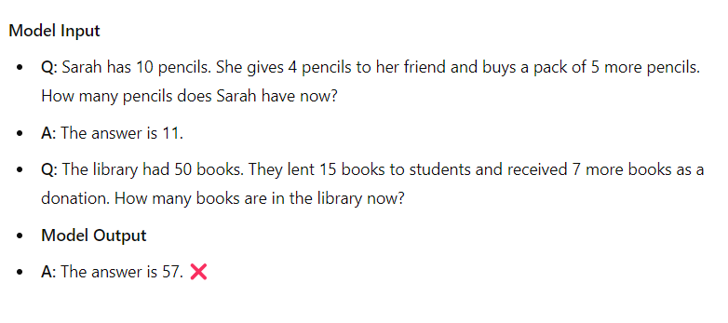
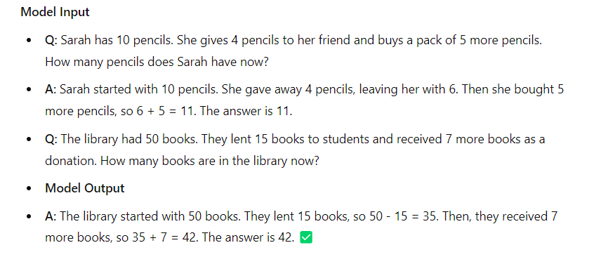
Prompt Engineering Techniques: Chain-of-Thought
Chain-of-thought prompting is a technique that improves the reasoning abilities of AI models by breaking down complex questions or tasks into smaller manageable steps.
It mimics how humans' reason and solve problems by systematically breaking down the decision-making process.
Standard Prompting
Chain-of-thought Prompting
© All rights reserved for Dr. Ryan Ahmed @Stemplicity Inc.

Slide 9

Key Learning Outcomes
Communicate with powerful AI vision models using their APIs.
Master the art of Prompt Engineering including context, instruction, input, & output indicator
Discover how to convert an image into a base64-encoded string for OpenAI API call.
Understand the difference between zero-shot few-shot and chain-of-thought prompting
© All rights reserved for Dr. Ryan Ahmed @Stemplicity Inc.

Slide 10

Summary
Learned how to develop intelligent, AI-powered applications that can process and interpret image data using OpenAI’s vision capabilities.
Understood that prompt engineering is both a skill and an art—well-structured prompts are essential for generating consistent and accurate outputs from AI models.
Gained practical skills in defining Python functions to perform specific tasks effectively and efficiently.
© All rights reserved for Dr. Ryan Ahmed @Stemplicity Inc.

Slide 11
Thank you!

